Slide 1
MULTITHREADED SORTING APPLICATION
YASHASWI DODDAVEERAPPA (STUDENT ID - 012468066)

Slide 2
Contents
PROBLEM STATEMENT
THREAD
MULTITHREADING
THREAD METHODS
MERGE SORT
TOOLS
IMPLEMENTATION
CONCLUSION
REFERENCES

Slide 3
Problem Statement
A list of N unsorted (it can be sorted also) integers is given as input.
The given list should be divided into two sub-lists.
A Thread must be assigned to each sub-list.
Sorting algorithm is to be applied on each of them and produce a final, merged sorted list of integers.

Slide 4
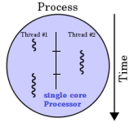
Basic Concepts
What is a Thread ?
A thread of execution is the smallest sequence of programmed instructions that can be managed independently by a scheduler, which is typically a part of the operating system.

Slide 5
What is Multi Threading ?
Multithreading is a widespread programming and execution model that allows multiple threads to exist within the context of one process.
These threads share the process's resources, but are able to execute independently.
Multithreading can also be applied to one process to enable parallel execution on a multiprocessing system

Slide 6
Applications of Multi-Threading ?
Faster execution
Better system utilization
Lower resource consumption
Parallelization

Slide 7
Thread methods implemented in our JAVA program.
start()
Invokes the run() method.
run()
Begins the execution of thread.
join()
Blocks the current thread until the child thread(s) completes its execution.

Slide 8
What is Mergesort ?
Mergesort is an efficient, general-purpose, comparison-based sorting algorithm.
Most implementations produce a stable sort, which means that the implementation preserves the input order of equal elements in the sorted output.
Mergesort is a divide and conquer algorithm that was invented by John von Neumann in 1945.
Space Complexity of Mergesort is O(log n)

Slide 9
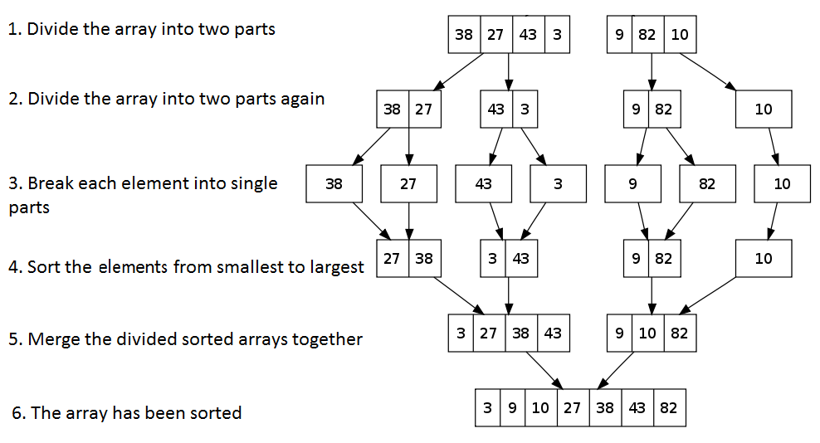

Slide 10
Tools :
IDE: Eclipse, Visual Studio
Programming Language : Java
Operating System :Linux

Slide 11
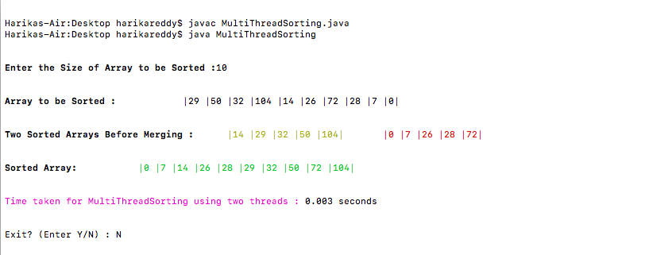
Project Implementation
Sorting Array with 10 Elements:

Slide 12
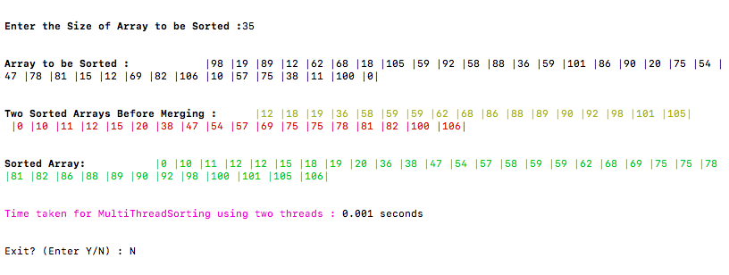
Sorting Array with 35 Elements:

Slide 13
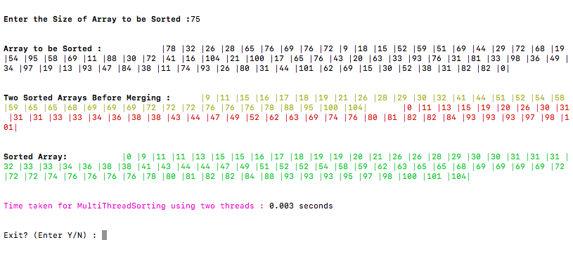
Sorting Array with 75 Elements:

Slide 14
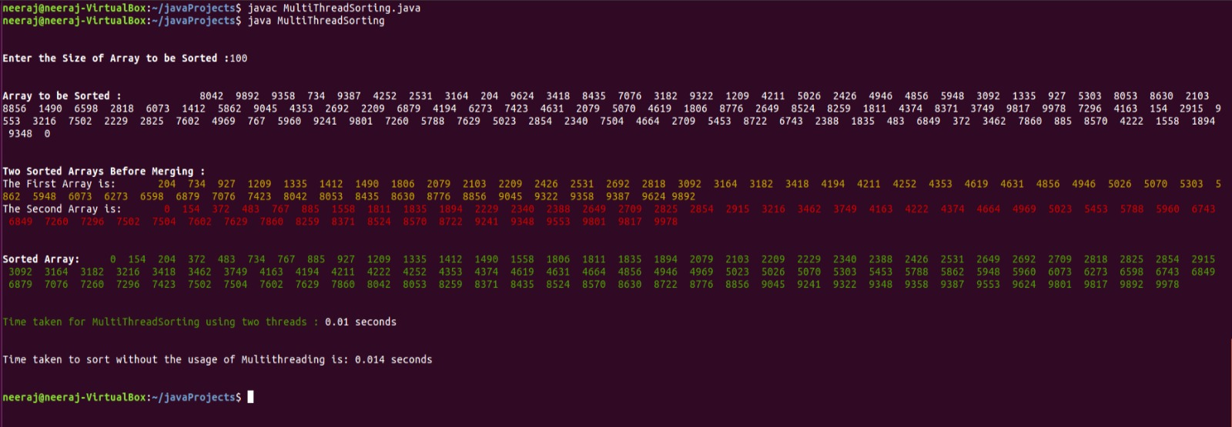

Slide 15
Conclusion
The list of N random integers is taken as input into the system and is sorted in ascending order using merge sort algorithm.
This algorithm is implemented using the concept of multithreading which enhances its performance.
The output shows the list of sorted integers along with the time taken for sorting.

Slide 16
References
Text Book
Operating System Concepts, Abraham Silberschatz, Peter Baer Galvin and Greg Gagne.
Links
https://www.geeksforgeeks.org/
www.tutorialspoint.com

Slide 17
THANK YOU

